Slide 1

Project Team No: 21SOCU1032
END SEMESTER-MINI PROJECT VIVA -VOCE
18-Jan-2022

Slide 2
Early Prediction of Heart Diseases using ML based Models
Presented By:
Darshan Kumar
122003059
(CSE-7th semester)
Guided By:
Professor EZHILARASIE R

Slide 3
INTRODUCTION

Slide 4
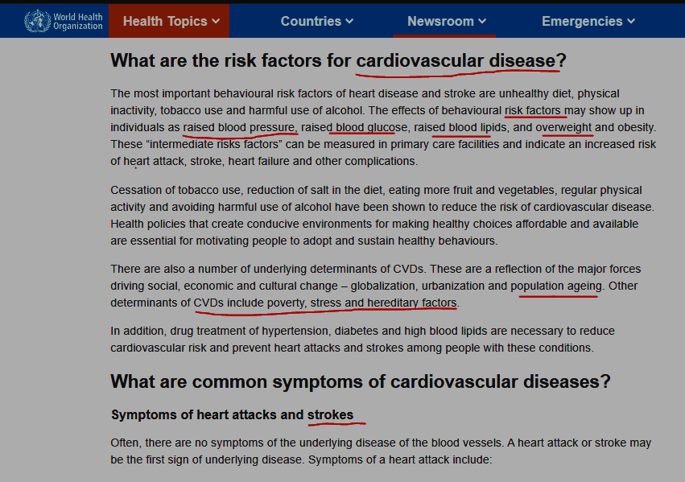
An article from WHO, highlighting the risks for CVD

Slide 5
SOURCE OF DATASET
Link: link
This dataset was given as a part of the contest, held at “Kaggle website”, to raise awareness about CVD, (as a initiative to support WHO).

Slide 6
DETAILED PROBLEM STATEMENT
To predict CVD ( cardiovascular diseases) early, using basic blood tests, smoking history, lifestyle habits etc. (which are easily accessible ,affordable in rural primary health centers, across India) , using ML based prediction models .
AIM:
Aim of the project is to compare the robustness, of the various ML models, and achieve a model, which is most robust, for the given dataset.

Slide 7
WORK PLAN
Serial no | aim | Expected Time Required
1 | Understanding the attributes given , using covariance, correlation etc to understand its relevance in predicting CVD Preprocessing the attributes | 15 days
2 | Understanding how the model works, learning its implementation in python. Training the ML models( knn, naïve bayes, etc) with the dataset | 1 month
3 | Evaluating the models(ppv, npv, sensitivity, etc) look for chances ,to further improve the models | 15 days

Slide 8
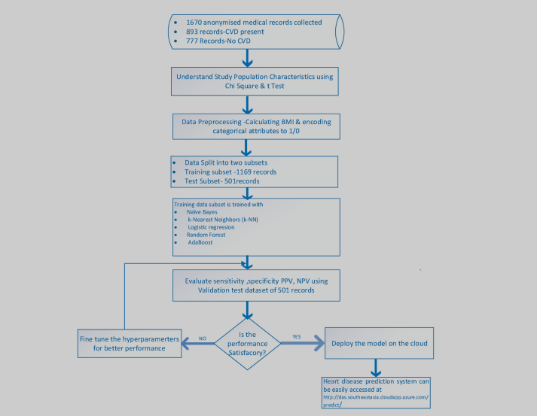
Algorithm (Methodology):

Slide 9
Literature Survey
Serial number | Title Of Paper | year | comments
1) | Design And Implementing Heart Disease Prediction Using Naïve’s Bayesian | 2019 | A full fledged application using naïve bayes model in backend, AES encryption being used For database security.
2) | Prediction of Heart Disease using Machine Learning Algorithms: A Survey | 2017 | Use of SVM, knn, decision tree based classifier
3) | A comprehensive investigation and comparison of Machine Learning Techniques in the domain of heart disease | 2017 | SVM is shown to be effective approach in high-dimensional space problems.(due to its computational efficiency)

Slide 10
I have referred the official documentation of SK-Learn, to understand, how the implementation of t-test, chi square test etc.
I have referred official documentation of Numpy library, to vectorize my code .(matrix multiplication ,element to element dot product)
I have seen several tutorials of experts , in YouTube, to understand how, models can be efficiently implemented.
I have referred prescribed textbooks of MLT subject(for B Tech):
C. M. Bishop. Pattern Recognition and Machine Learning. Springer: 2006

Slide 11
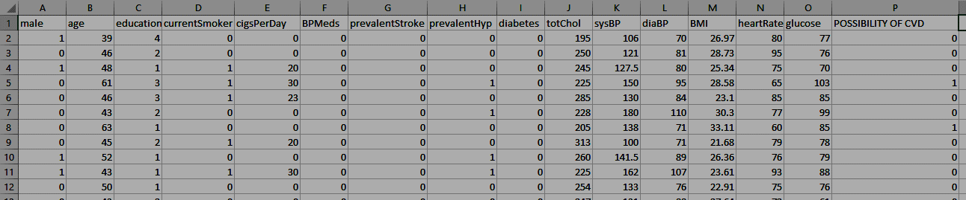
MY DATASET, FOR THIS PROJECT (4.2k records , 15 Attributes , 200 KB size) original dataset used in base paper has 1670 records, 13 attributes
BPMeds= existing medication for BP
prevalentHyp= prevalent hypertension
totChol= total cholesterol
sysBP=systolic blood pressure(avg over 24 hours)
diaBP=diastolic blood pressure (avg over 24 hours)
BMI=body mass index(calculated using height, weight)

Slide 12
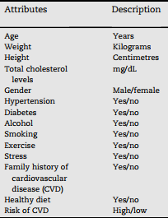
Comparison of attributes taken in base paper, with attributes of my dataset
Base paper attributes | Equivalent attribute in my dataset
Age | Age
Weight | BMI
Height | BMI
Total cholesterol level | totChol
gender | Male
hypertension | prevalentHyp
diabetes | Diabetes
alcohol | ------
Smoking | currentSmoker ,cigsPerDay
Exercise | heartrate
Stress | sysBP, diaBP, Bpmeds, diabetes, BMI
Family history of cvd | prevalentHyp, BPMeds
Healthy diet | ------
Risk of cvd | Possibility of cvd
Base paper attributes
My dataset attributes

Slide 13
IMPLEMENTATION DETAILS

Slide 14

TESTS PERFORMED (TO IDENTIFY USEFUL ATTRIBUTES) [ P value-is a measure of randomness in attributes, w.r.t target attributes]
Test | Features | Threshold Value, used in Project
T-test | Measures the probability , that the results occurs by chance | P<0.05
Correlation Test | Measure of linear association, between 2 variables | Correlation coefficient>0.09
Chi-Square Test | Measure of independence , between 2 variables | p<0.05
Conclusions:

Slide 15
DEALING WITH MISSING VALUES
TYPE OF ATTRIBUTE | MEATHOD USED
CONTINOUS ATTRIBUTES | Replace “Nan” values, with mean.
2) CATEGORICAL ATTRIBUTES | Replace “Nan” with ,most frequent value.

Slide 16
IMPLEMENTATION OF MODELS

Slide 17
ALGORITHM | Explanation
K nearest neighbor | No training is involved, no parameters are learnt, final result is based on “majority vote”.
Naïve Bayes Classifier | Extended bayes theorem is used, to find conditional probability wrt each class. The one, with higher probability wins. Laplace smoothing is used, to deal with 0 probability cases.
Logistic Regression | Gradient descent is used to learn the parameters. Sigmoid function is used to reduce the values to 0,1.
Random Forest (base learner: decision trees) | each learners , become specialized in the portion of the data set they receive(for training).final result is based on “majority vote” . It is the best choice, to avoid over-fitting.
Adaptive Boosting (weak learner: decision trees) | Sequential learners are used Only those records , which are wrongly classified by 1st learner, are used to train, 2nd learner.

Slide 18
K-Nearest Neighbor hyper parameters: no of neighbors
accuracy= 0.8490566037735849
sensitivity= 0.047619047619047616
specificity= 0.9889196675900277
PPV= 0.42857142857142855
NPV= 0.8561151079136691

Slide 19
Naïve Bayes Classifier
accuracy= 0.8309748427672956
sensitivity= 0.23809523809523808
specificity= 0.9344413665743305
PPV(positive predicted value)= 0.3879310344827586
NPV(negative predicted value)= 0.8754325259515571

Slide 20
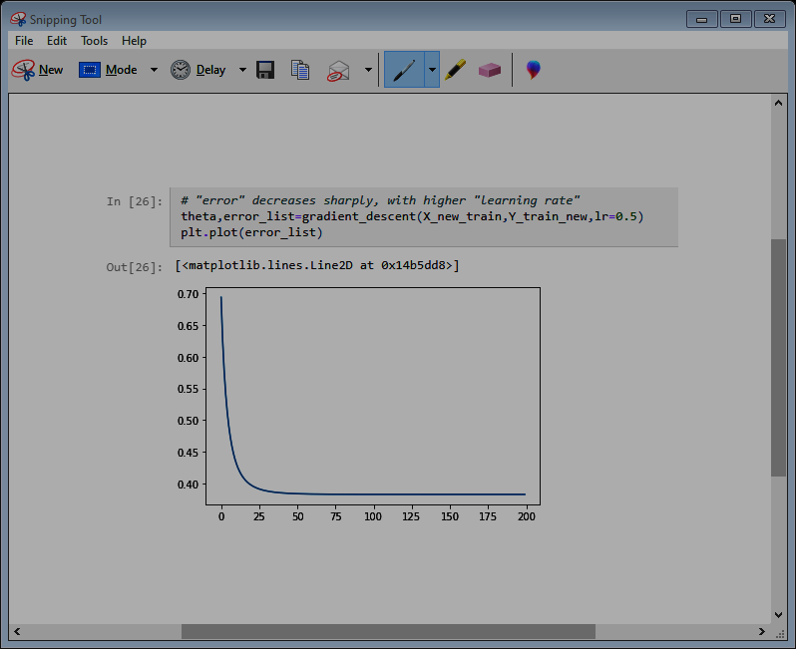
Logistic Regression hyper parameters: learning rate
accuracy= 0.8545597484276729
sensitivity= 0.06349206349206349
specificity= 0.9926131117266851
PPV= 0.6
NPV= 0.8586261980830671
x axis: no of iterations, for gradient descent(learning rate=0.5)
y axis: error value

Slide 21
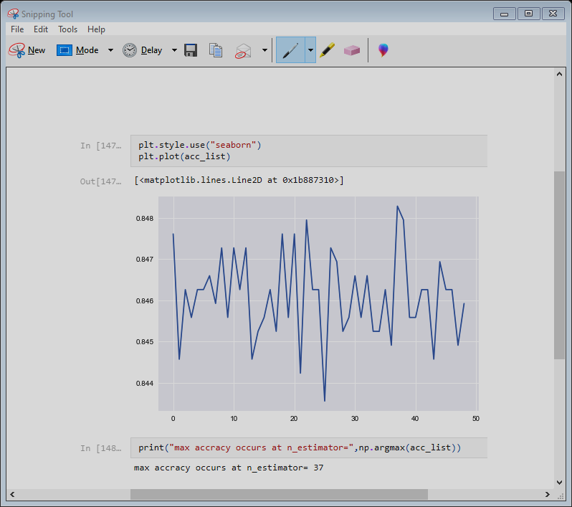
Random Forest Classifier hyper parameters: no of decision trees, max depth, entropy/gini-index
accuracy= 0.8522012578616353
sensitivity= 0.015873015873015872
specificity= 0.9981532779316713
PPV= 0.6
NPV= 0.8531965272296764
x axis: no of decision trees used
y axis: accuracy of model
I have used “max_depth”=5, in all my implementations, due to intensive, calculations , involved, with larger depth.

Slide 22
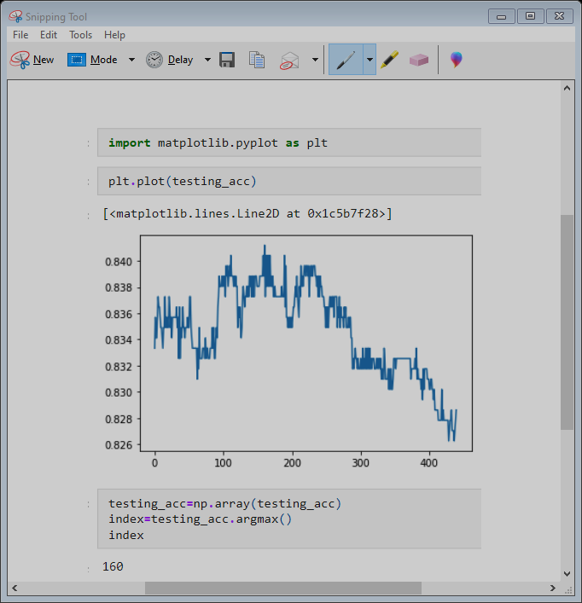
Adaptive boosting Implementation hyper parameters : no of estimators, learning rate
accuracy= 0.8364779874213837
sensitivity= 0.1111111111111111
specificity= 0.9630655586334257
PPV= 0.3442622950819672
NPV= 0.861271676300578
x axis: no of weak learners(decision trees,with depth=1) used
y axis: accuracy of model

Slide 23
Summarizing Results

Slide 24
Comparing “Accuracy” of Models
Model | Accuracy on Test Data
K-Nearest Neighbor | 0.8490566037735849
Naïve Bayes Classifier | 0.8309748427672956
Logistic Regression | 0.8545597484276729
Random Forest Classifier | 0.8522012578616353
Adaptive Boosting Technique | 0.8364779874213837

Slide 25
Conclusions:
Old Age, history of hyper tension, presence of high BP, were seen as the most contributing factors for CVD.
Un-controlled blood glucose levels, is also found to be a risk factor, for CVD.
Males were found to be more prevalent to face CVD.
Raised cholesterol, was also found to be a warning, for CVD.
*The above conclusions were made from correlation test

Slide 26
Deployed Model On Web

Slide 27
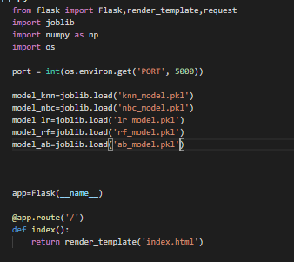
Explaining the Working Of Flask

Slide 28
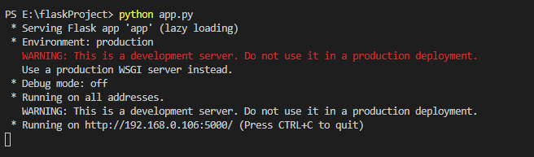
Starting the Server (in localhost)

Slide 29
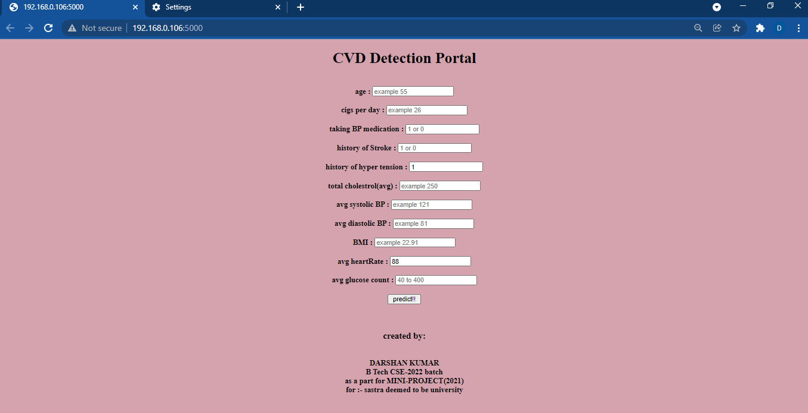
Step 1: Fill the Data

Slide 30
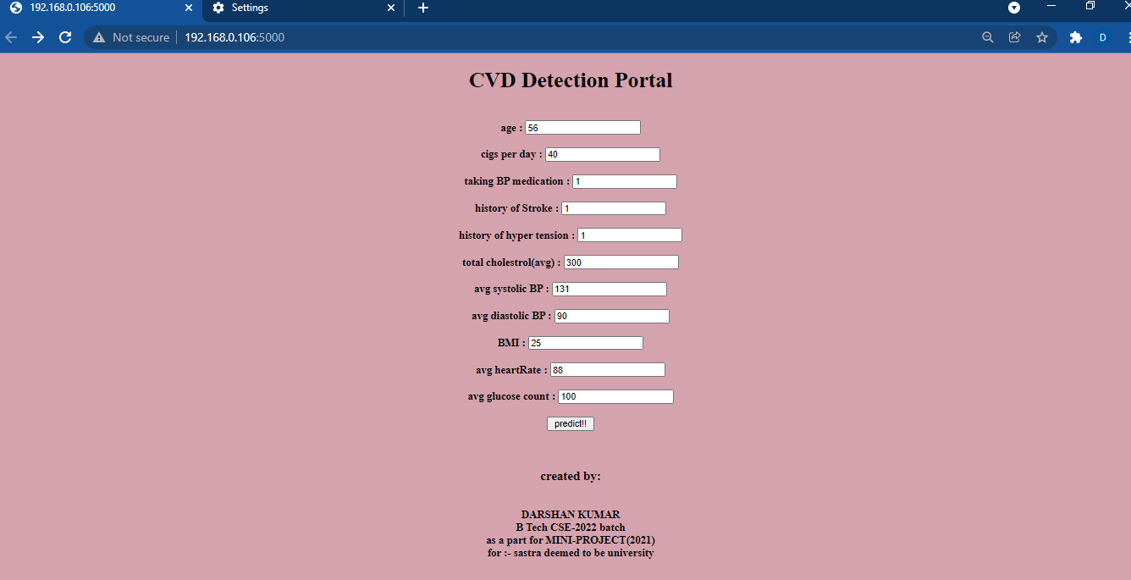
Step 2: click Predict button

Slide 31
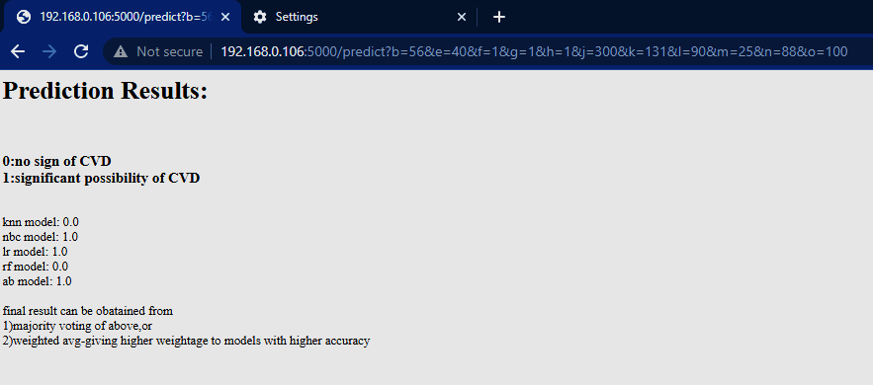
Prediction by each model

Slide 32
Thank You!!

